Slide 1
Chapter 4 Selections
(also called) If statements
(also called) Conditional Logic

Slide 2
Motivations
If you assigned a negative value for radius in Listing 2.1, ComputeArea.py, the program would print an invalid result. If the radius is negative, you don't want the program to compute the area. How can you deal with this situation?

Slide 3
Objectives
To write Boolean expressions by using comparison operators
To generate random numbers
To program with Boolean expressions (AdditionQuiz)
To program with if statements (GuessBirthday)
To program with if / else statements
To program with if / elif ... elif / else statements
To avoid common errors in if statements
To combine conditions using logical operators (and, or, and not)
If statements with combined conditions (LeapYear, Lottery)
To be aware of operator precedence and the need for parentheses

Slide 4
Boolean Data Types
Often in a program you need to compare two values, such as whether i is greater than j. There are six comparison operators (also known as relational operators) that can be used to compare two values. The result of the comparison is a Boolean value: true or false.
b = (1 > 2)

Slide 5
Comparison Operators
Operator Name
< less than
<= less than or equal to
> greater than
>= greater than or equal to
== equal to
!= not equal to

Slide 6
Problem: A Simple Math Learning Tool
This example creates a program to let a first grader practice additions. The program randomly generates two single-digit integers number1 and number2 and displays a question such as “What is 7 + 9?” to the student. After the student types the answer, the program displays a message to indicate whether the answer is true or false.
AdditionQuiz
Run

Slide 7
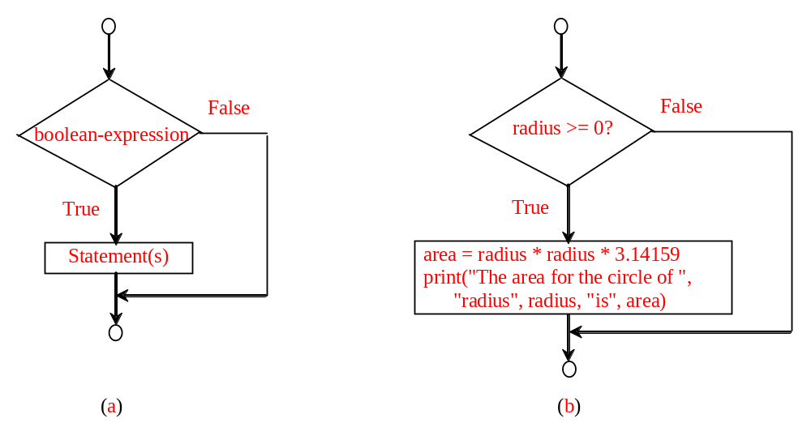
if Statements
if radius >= 0:
area = radius * radius * 3.14159
print("The area for the circle of radius“,
radius, "is“, area)
if boolean-expression:
statement(s)

Slide 8
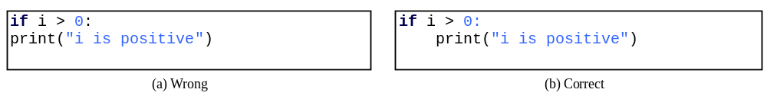
Note

Slide 9
Simple if Demo
Write a program that prompts the user to enter an integer. If the number is a multiple of 5, print HiFive. If the number is divisible by 2, print HiEven.
SimpleIfDemo
Run

Slide 10
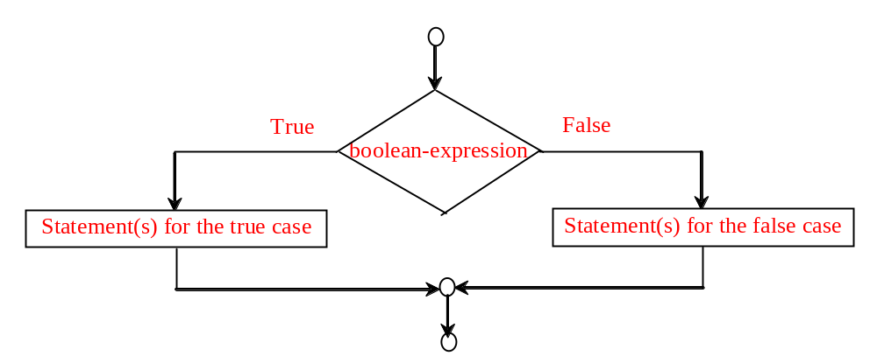
if / else Statement
if boolean-expression:
statement(s)-for-the-true-case
else:
statement(s)-for-the-false-case

Slide 11
If / else Example
if radius >= 0:
area = radius * radius * math.pi
print("The area for the circle of radius", radius, "is", area)
else:
print("Negative input")

Slide 12

Problem: An Improved Math Learning Tool
This program teaches a child how to do simple subtraction. It randomly generates two single-digit integers, number1 and number2, possibly having to switch the numbers so that number1 is > number2. Then the program displays a question such as “What is 9 – 2?” After the student types the answer in the input dialog box, the program indicates whether or not the answer was correct.
Note the code that switches the numbers uses "python only" syntax. It's best if you learn the "normal way":
Python only syntax:
num1, num2 = num2, num1
Most languages must do:
tmp=num1
num1=num2
num2=tmp
SubtractionQuiz

Slide 13
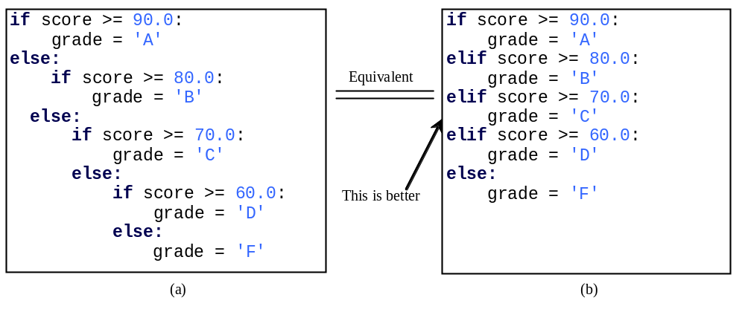
Multiple Alternative if Statements

Slide 14
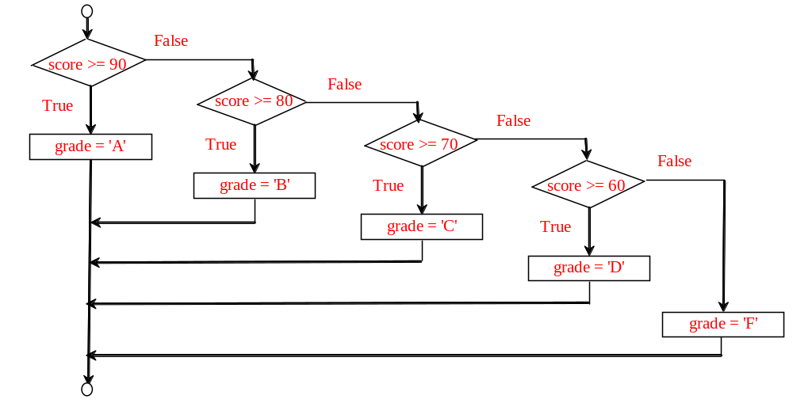
Flowchart

Slide 15
Trace if-else statement
animation
Suppose score is 70.0
The condition is false
if score >= 90.0:
grade = 'A'
elif score >= 80.0:
grade = 'B'
elif score >= 70.0:
grade = 'C'
elif score >= 60.0:
grade = 'D'
else:
grade = 'F'

Slide 16
Trace if-else statement
animation
Suppose score is 70.0
The condition is false
if score >= 90.0:
grade = 'A'
elif score >= 80.0:
grade = 'B'
elif score >= 70.0:
grade = 'C'
elif score >= 60.0:
grade = 'D'
else:
grade = 'F'

Slide 17
Trace if-else statement
animation
Suppose score is 70.0
The condition is true
if score >= 90.0:
grade = 'A'
elif score >= 80.0:
grade = 'B'
elif score >= 70.0:
grade = 'C'
elif score >= 60.0:
grade = 'D'
else:
grade = 'F'

Slide 18
Trace if-else statement
animation
Suppose score is 70.0
grade is C
if score >= 90.0:
grade = 'A'
elif score >= 80.0:
grade = 'B'
elif score >= 70.0:
grade = 'C'
elif score >= 60.0:
grade = 'D'
else:
grade = 'F'

Slide 19
Trace if-else statement
animation
Suppose score is 70.0
Exit the if statement
if score >= 90.0:
grade = 'A'
elif score >= 80.0:
grade = 'B'
elif score >= 70.0:
grade = 'C'
elif score >= 60.0:
grade = 'D'
else:
grade = 'F'

Slide 20
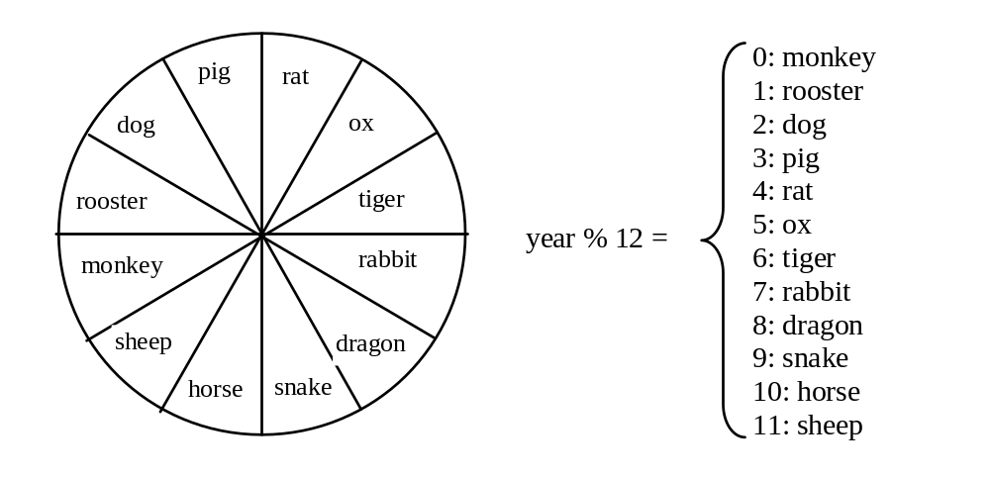
Example
Now let us write a program to find out the Chinese Zodiac sign for a given year. The Chinese Zodiac sign is based on a 12-year cycle, each year being represented by an animal: rat, ox, tiger, rabbit, dragon, snake, horse, sheep, monkey, rooster, dog, and pig, in this cycle.
ChineseZodiac

Slide 21
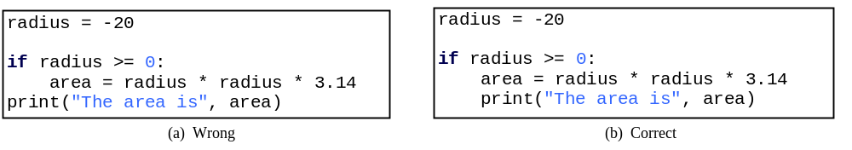
Common Errors
Most common errors in selection statements are caused by incorrect indentation. Consider the following code in (a) and (b).

Slide 22
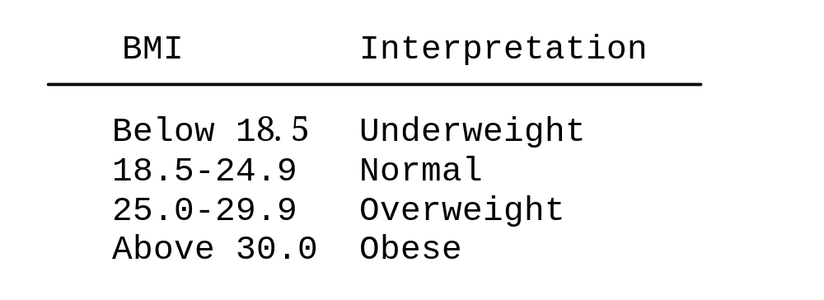
Problem: Body Mass Index
Body Mass Index (BMI) is a measure of health on weight. It can be calculated by taking your weight in kilograms and dividing by the square of your height in meters. The interpretation of BMI for people 16 years or older is as follows:
ComputeBMI

Slide 23
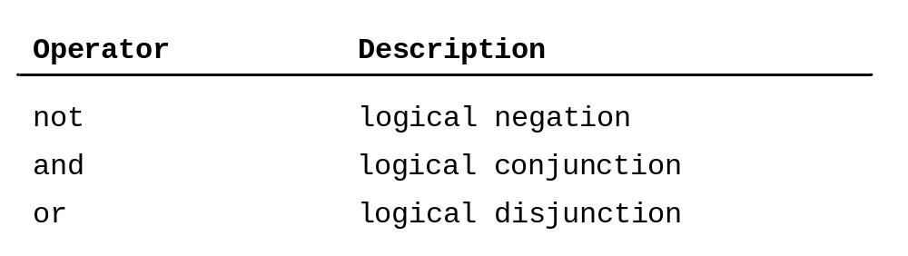
Logical Operators

Slide 24
Operator not
x=input("Enter a number less than 100: ")
x=int(x) # must convert string to number before
# can compare that to another number
if not (x<100):
print ("you didnt follow directions")
else:
print("good job")
print ("thank you for running this program") # prints every time
# because it is not indented like the "good job" line.

Slide 25
Operator and
x=input("Enter a number 1..100: ")
x=int(x) # must convert string to number
if (x>=1) and (x<=100):
print ("good job")
else:
print("number is out of range")
print ("thank you for running this program")

Slide 26
Operator or
x=input("Enter a number 1..100: ")
x=int(x) # must convert string to number
if (x <1) or (x>100):
print("number is out of range")
else:
print ("good job")
print ("thank you for running this program")

Slide 27
Examples
Here is a program that checks whether a number is divisible by 2 and 3, whether a number is divisible by 2 or 3, and whether a number is divisible by 2 or 3 but not both:
TestBooleanOperators
Run

Slide 28
Problem: Determining Leap Year?
This program first prompts the user to enter a year as an int value and checks if it is a leap year.
A year is a leap year if it is divisible by 4 but not by 100, or it is divisible by 400. Remember that the % operator gives you the remainder from a division operation.
(year % 4 == 0 and year % 100 != 0) or (year % 400 == 0)
LeapYear
Run

Slide 29
Operator Precedence
In math, some operators have precedence over others, for example, * and / will be done before + and -.
Please Excuse My Dear Aunt Sally
Parenthesis Exponent Mulitply Divide Add Subtract
I don’t expect you to memorize the precedence of all the different mathematical operators (even though the mnemonic has Sally in it), but just remember to use parentheses so that you get the calculation you expect.

Slide 30
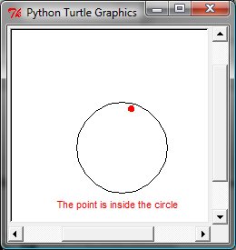
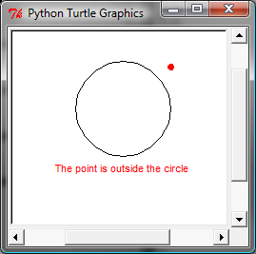
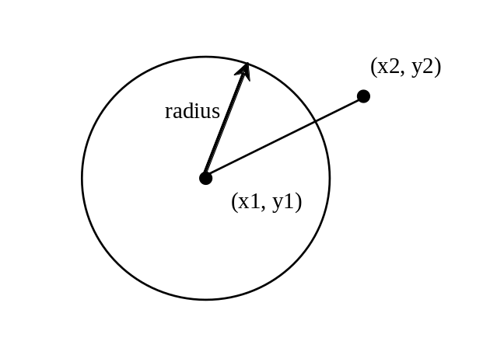
Turtle: Location of an Object
Test whether a point is inside a circle. The program prompts the user to enter the center of a circle, the radius, and a point.
PointInCircle

